Slide 1

Machine learning

Slide 2

1. Neural nets
Machine learning CityLit Liv Helen Våge

Slide 3

Course outline
Session 1
Intro to ML
Data pre-processing and pandas
Session 2
Regression
Random forest, boosted decision trees
Session 3
Artificial neural nets
Session 4
Unsupervised learning
Clustering methods

Slide 4
Session outline
Go through homework
Practical neural net theory
How it works
How to choose hyperparameters
Make neural nets
Using data frame
Using image

Slide 5
Neural net
X₁w₁+X₂w₂ +b
> threshold
Mass of b-pair
w₁
tanh
w₃
(2,5,6,2...)
tanh
w₂
Momentum
S
S
(5,8,10,2...)
tanh
Number of jets
B
B
(5,5,1,7...)
tanh

Slide 6
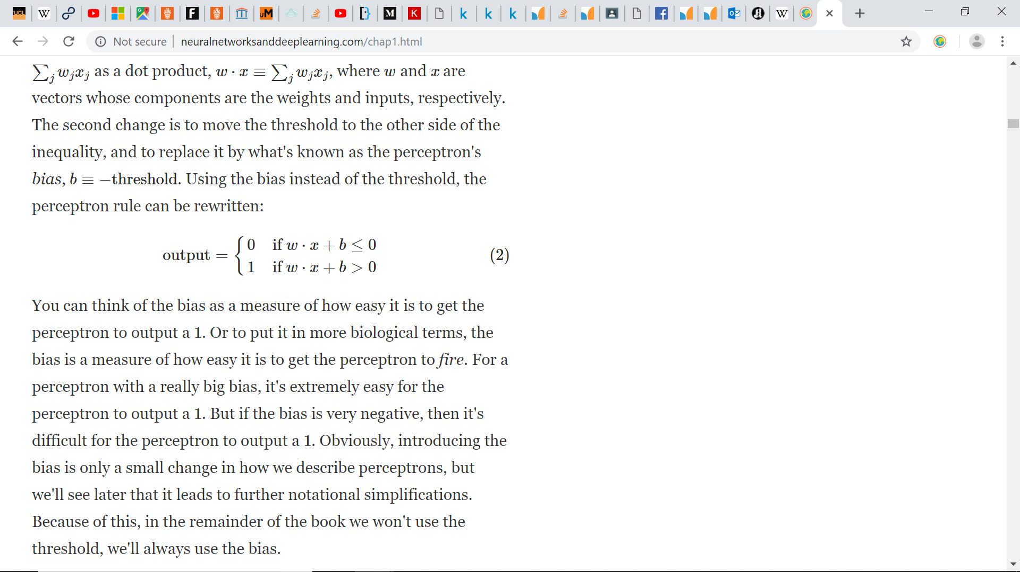
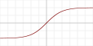
Activation function
ReLu
Softmax
Sigmoid

Slide 7
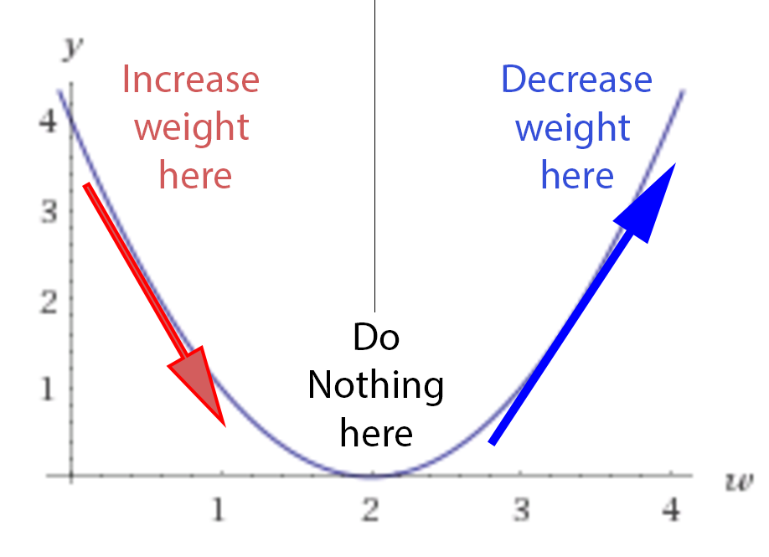

Slide 8
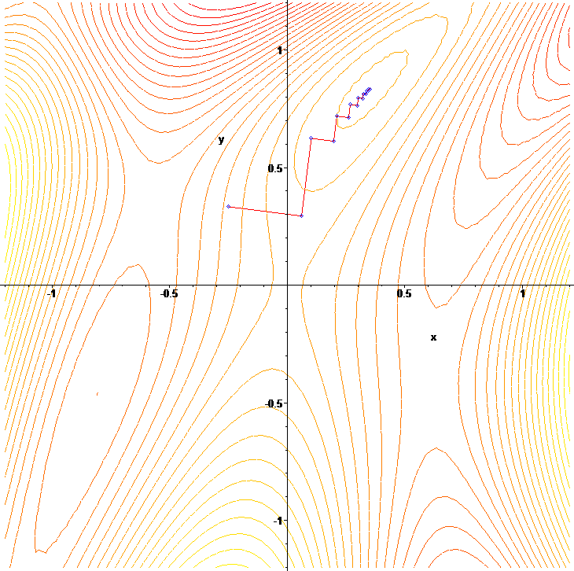
Batch training
Batch size
is typically chosen between 1 and a few hundreds, e.g. B = 32 is a good default value

Slide 9

(…) “found that using the same size for all layers worked generally better or the same as using a decreasing size (pyramid-like) or increasing size (upside down pyramid), but of course this may be data-dependent. For most tasks that we worked on, we find that an overcomplete first hidden layer works better than an undercomplete one. “
For number of layers you need to experiment ☺

Slide 10
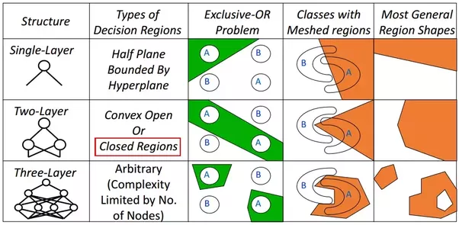
How many layers?
One layer is enough for most problems… Or?
Each layer in a multi-layer neural network typically has a size that we are free to set and that controls capacity.
Because of early stopping and possibly other regularizers (e.g., weight decay, discussed below), it is mostly important to choose nh large enough. Larger than optimal values typically do not hurt generalization performance much, but of course they require proportionally more computation

Slide 11
Weight decay
Sometimes to avoid overtraining, you can make nodes disappear if they aren’t used

Slide 12
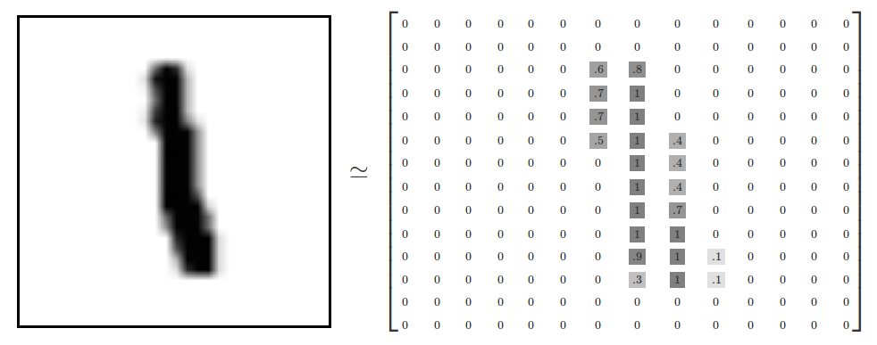
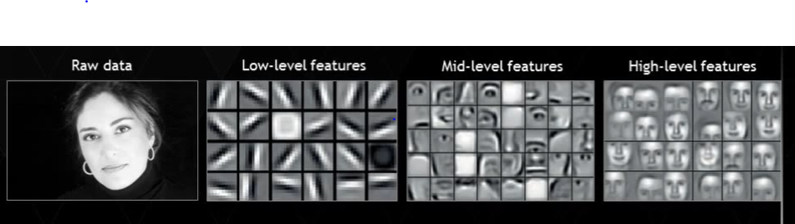
Neural nets for images
https://www.youtube.com/watch?v=aircAruvnKk

Slide 13

Convolutional neural nets

